Slide 1
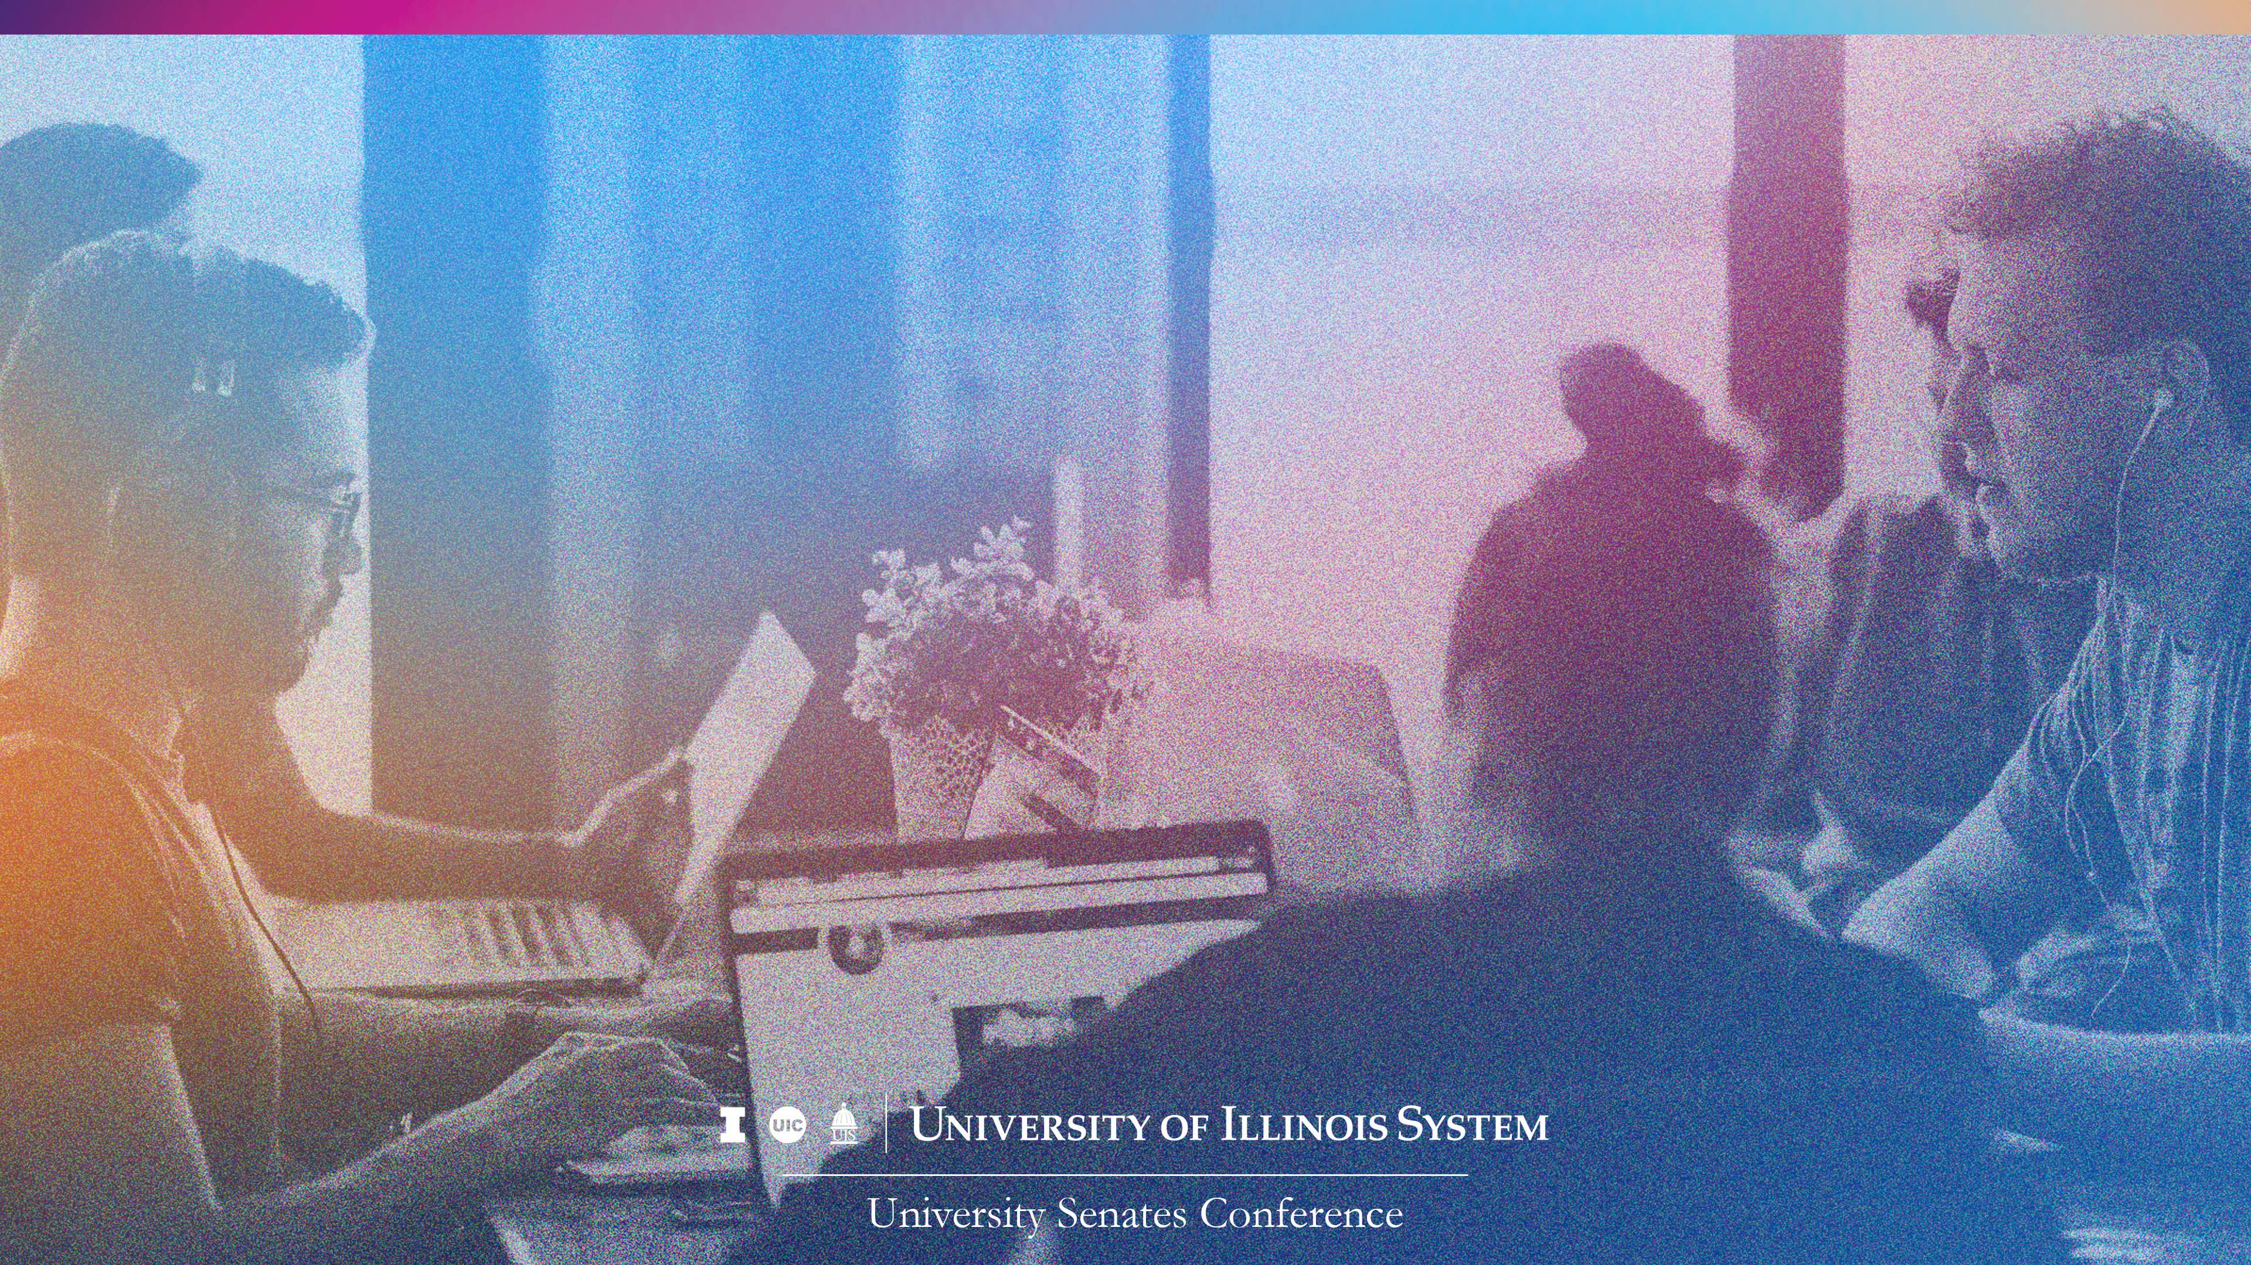
University Senates Conference Report
Presentation to the Board of Trustees
Sandra De Groote, USC Chair
September 22, 2022

Slide 2
University Senates Conference (USC):
Coordinates the work of the university senates
Provide advice
on revisions to the Statutes
and General
Rules
Act as advisory group to the president and the Board (through president)

Slide 3

University Senates
  The University of Illinois Statutes provide for a senate to be constituted at each university, to exercise legislative functions in matters of educational policy, such as requirements for admission to colleges and schools, requirements for degrees and certificates, and the academic calendar.
  Each senate shall also recommend candidates for honorary degrees and may propose amendments to the Statutes through the University Senates Conference to the president and the Board of Trustees.
  Have own bylaws and committee structures (executive committee, budge, educational policy, academic freedom & tenure, external relations, faculty affairs and more…)
  Also provide feedback and/or approve policies at university level related to faculty

Slide 4
USC Full Membership 2022-2023
UIC | UIS | UIUC
Larry Danziger | Lynn Fisher | Sara Benson
Sandra De Groote | Sudeep Sharma | Nicholas Burbules
Danilo Erricolo | Celest Weuve | Roy Campbell
Keia Hobbs |  | John Dallesasse
Farid Peiravian |  | Jeffrey Eric Jenkins
Michael Stroscio |  | Prasanta Kumar Kalita
Donald Wink |  | Carol Leff
 |  | William Maher
 |  | Joyce Tolliver
 |  | Helga Varden

Slide 5
USC Executive Committee 2022-2023
Sandra (Sandy) De Groote, Chair (UIC)
Celest Weuve, Vice Chair (UIS)
Nicholas Burbules (UIUC)
Danilo Erricolo (UIC)
Lynn Fisher (UIS)
Jeffrey Eric Jenkins (UIUC)

Slide 6

Three USC Standing Committees
  Academic Affairs and Research
  Finance, Budget, and Benefits
  Statutes and Governance

Slide 7

Ongoing Activities
Engagement in Shared Governance
Input on policies shared by President’s office
Advice on revisions to the Statutes and General Rules
USC retreat - healthy relationships, review Code of Conduct, input on topics discussed at BOT retreat

Slide 8

USC Mission:
To work for the greater good of the
University of Illinois and all of its Universities.
University Senates Conference
  As elected representatives of the faculty of the three universities, USC looks forward to working with you all to uphold the values of the University of Illinois and to continue to have an impact in the areas of academic excellence, research and discovery, health and healthcare, public engagement, and economic development.

