Slide 1
REMARKS TO THE BOARD OF TRUSTEES
REMARKS TO THE BOARD OF TRUSTEES
President Tim Killeen
September 22, 2022
Notes:
Welcome to our first Board of Trustees meeting for the 2022-2023 academic year.
The University of Illinois System is off to a great start, and I look forward to sharing some exciting updates that both underscore our progress to date and bolster our positioning for the future.
My personal welcome and thanks to our new trustees, Joe Gutman and Sylvia Puente. I appreciate your commitment to serve and the valuable contributions I know you’ll make in guiding our continued success as a system.
Today, I want to provide a bit of an overview of our progress in pursuit of our mission and where we stand today, which, by the way, is quite favorable. I might even venture to say we’re on the most solid footing ever.

Slide 2
Our platform for performance
Our Platform for
PERFORMANCE
Notes:
You’ve heard me talk previously about our platform for performance. The notion of having untapped capacity, standing poised to take off and realize an ambitious vision for what’s next.
Now more than ever, the system is in a very strong position to capitalize on new opportunities and perform at even higher levels …
… identifying pressing problems in need of solutions …
… and answering the call for action to generate the kinds of impact at scale that will allow us to further lead transformational change.

Slide 3
Our strategic pillars
OUR STRATEGIC PILLARS
AN INSTITUTION OF AND FOR STUDENTS
RESEARCH AND SCHOLARSHIP WITH GLOBAL IMPACT
HEALTHY FUTURE FOR ILLINOIS AND THE MIDWEST
TOMORROW’S UNIVERSITY TODAY
Notes:
As we think about the strength of this platform -- of the work we’re doing and the continued opportunity it is creating for the future -- our efforts remain tied to a strategic framework that is anchored in four main pillars.
Of course, it was our board of trustees back in 2015 and 2016 that guided us as we embarked upon a course of thoughtful strategic planning. I was grateful then -- as I am now – for our trustees’ faithfulness to the strategic framework that has informed our efforts along the way and is continuing to do so well into 2022 and beyond.
I want to offer a quick snapshot of several of the achievements that have brought the U of I System to this critical jumping off point. And how, moving forward, this platform will allow us to be bigger, bolder and brassier.
How it is creating future opportunity to advance our goals around education and research and improving the overall health and well-being of citizens in the state and region.
How it is inspiring us to constantly look forward, to stay a step ahead, and retool and rebuild to future-proof today’s university to meet the needs of an ever-changing higher education landscape.
Progress in all these areas has come in many different programs and initiatives throughout the system. I’m so proud of our students, faculty, staff and administration for their tireless efforts to strengthen our platform and move us forward.

Slide 4
enrollment
SUSTAINED ENROLLMENT GROWTH
^{94,861 STUDENTS}
16% GROWTH OVER 5 YEARS
Notes:
Enrollment across our three-university system reached a record high this fall of 94,861, driven by managed growth after five years of robust expansion.
This modest increase is in line with our plan to grow at a more moderate pace this year after seeing enrollment gains of 16 percent over the five previous academic years. You may recall enrollment growth surpassed the initial target of about 93,600 students by the fall of 2021 -- a milestone we’re proud to have reached.

Slide 5
Modest tuition increase
MODEST TUITION INCREASE
1.8%
1.8%
1.5%
Notes:
At the same time, tuition increased at a very modest rate this fall – up just 1.8 percent for incoming in-state freshmen in Urbana-Champaign and Chicago, and just 1.5 percent in Springfield. Under Illinois’ guaranteed tuition law, currently enrolled in-state students saw no tuition increase.
These increases are well below the rate of inflation – the Consumer Price Index has increased by an average 2.6 percent per year over the past four years, including a 6.2 percent increase over the past 12 months.

Slide 6
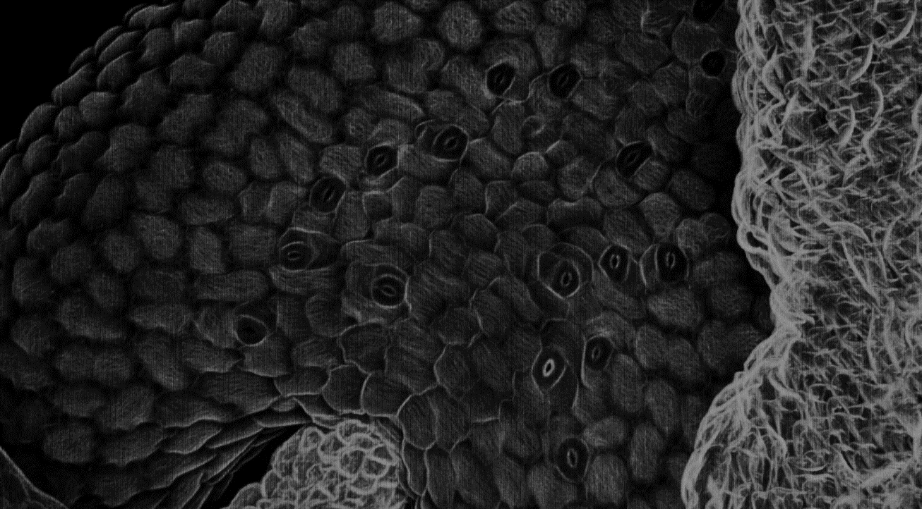
research
RESEARCH
$1.2B
UP FROM $1.1B IN 2020
FY21
20% INCREASE FROM 2010 - 2020
Notes:
Our top-notch researchers and developers are continually discovering practical applications for their research that provide solutions to real-world problems generated through exploration, collaboration, and innovation.
In fact, U of I System universities remain among the most innovative in the world and receive more National Science Foundation grant dollars than any other research institution.
I’m pleased to report that for FY21, R & D expenditures totaled $1.2 billion -- up from $1.1 billion in 2020. This continues a trend between 2010 and 2020, during which we saw expenditures increase by 20 percent.
A few examples of the major research initiatives that are a part of this significant growth and impact include:
A $200 million, 10-year investment for collaboration between IBM, our Grainger School of Engineering in Urbana-Champaign and the State of Illinois for the Discovery Accelerator Institute. This research partnership will bolster technical skills and accelerate breakthroughs in cloud, AI, quantum computing, materials discovery, and sustainability.
A $22 million grant from the National Institutes of Health over four years to research long COVID-19. The University of Illinois Chicago is leading an Illinois-based research consortium called ILLInet RECOVER, which has been selected to participate as one of the cohorts in the NIH initiative.
The work of the University of Illinois Springfield through the Center for Lincoln Studies, which provides students, faculty, scholars, and the public opportunities to understand the life and times of the 16th President and his impact on the modern period.
An $18 million project led by our Discovery Partners Institute together with Argonne National Labs to leverage the complementary research expertise and resources from both organizations. Faculty from DPI and our three universities, and researchers from Argonne and other institutions have been invited to submit seed grant proposals on the topics of: the Nexus of Energy, Water and Food; Energy Infrastructure and Transportation; and Climate and Sustainability.

Slide 7
State partnership
OUR PARTNERSHIP WITH THE STATE
IDPH AND SHIELD IL $200M AGREEMENT
Notes:
Our strong relationship with state legislators and the governor – and their continued investment in the U of I System -- is a testament to our progress and the impact we make.
Particularly illustrative of this robust partnership is the $200 million agreement with the Illinois Department of Public Health to expand SHIELD Illinois COVID-19 testing. Now offered at no cost to every public school outside of Chicago, this commitment will continue to save lives in Illinois.

Slide 8
State partnership
OUR PARTNERSHIP WITH THE STATE
5%
5%
increase in FY23 appropriations
supplemental increase for FY22
Notes:
Also a reflection of the State’s support, you may recall the budget for Fiscal Year 2023 passed earlier this year provides $655.2 million in general operating funds to the University of Illinois System -- an increase of 5 percent over last year.
The budget also applied an additional $28.1 million or 5 percent supplemental appropriation to Fiscal Year 2021’s $622 million in state operating funds, essentially having provided the 5 percent FY 2023 increase a year early.
We’re grateful for the General Assembly’s further recognition of the impact we are continuing to make for the State of Illinois.

Slide 9
Economic impact
ECONOMIC
IMPACT
Notes:
That impact can be seen in the key findings from our recently completed economic impact study. I reported on a few of these at our last meeting, but I want to quickly reiterate some of the topline numbers, because they are truly impressive.

Slide 10
Total state wide economic impact
$19B
IN TOTAL ILLINOIS STATEWIDE ECONOMIC IMPACT
Notes:
In FY 2021, the U of I System added $19 billion in added income for the Illinois economy!
This is up from $17.5 billion in FY17, an increase of 8.6 percent, and represents a value approximately equal to 2.1 percent of Illinois’ gross state product (GSP).

Slide 11
Jobs supported by system activities
1 IN 46
ILLINOIS JOBS SUPPORTED BY SYSTEM ACTIVITIES
Notes:
One in 46 Illinois jobs is supported by system activities.

Slide 12
Student return on investment
STUDENT ROI
$5.20
FOR EVERY $1 STUDENTS INVEST
15.7% ANNUAL RATE OF RETURN COMPARED TO U.S STOCK MARKET’S 30-YEAR AVERAGE RATE OF 10.5 PERCENT
Notes:
For every dollar students invest in an education at a U of I System university, they receive $5.20 in higher future earnings. That is a 15.7 percent annual rate of return, compared to the U.S. stock market’s 30-year average rate of return of 10.5 percent.

Slide 13
Growing our impact
GROWING OUR IMPACT
75%
SYSTEM GRADUATES REMAIN IN ILLINOIS
Notes:
A growing number of U of I System graduates are remaining in Illinois – 75 percent. That is up from 64.5 percent in FY 17, adding to the system’s impact on the state economy.

Slide 14
Total state wide economic impact
$1.3B
IN ANNUAL RESEARCH THAT DRIVES POSITIVE CHANGE
Notes:
System research spending generated $1.3 billion in added income for the Illinois economy in FY 21.

Slide 15
UI HEALTH
$1.6B
HOSPITAL IMPACT FROM RESEARCH AND TEACHING
Notes:
Spending by the University of Illinois Hospital & Health Sciences System (UI Health) generated $1.6 billion in added income for the state’s economy.

Slide 16
TAXPAYER RETURN ON INVESTMENT
TAXPAYER ROI
$3.10
FOR EVERY $1 TAXPAYERS INVEST
THE AVERAGE ROI FOR TAXPAYERS IS 60.8%
Notes:
For every dollar of public money invested in the U of I System, taxpayers will receive a return of $3.10 over the course of students’ working lives through additional taxes collected on higher earnings and reduced public costs for health care, social services and the justice system.
The average annual return on investment for taxpayers is 60.8%.

Slide 17
U.S. NEWS AND WORK REPORT BEST COLLEGES RANKING
Notes:
For those keeping score at home – and we know there are a lot out there who do – external recognition came recently via U.S. News and World Report’s results for 2022-2023, which ranked all three of our universities high among public institutions and moving up.
Although I’m personally not a big believer in these kinds of rankings, they reinforce what we already know to be true based on other metrics that demonstrate our universities’ stature and success.

Slide 18
OUR STRONG FOUNDATION
Our Strong Foundation
FOR THE FUTURE
Notes:
As we look ahead, the foundation established through these accomplishments -- the strength of our platform -- is allowing us to capitalize on opportunities that will continue to propel us into the future.
I’m pleased to share a few of the initiatives currently underway that are really beginning to take off.

Slide 19
Philanthropic campaign success
Philanthropic
CAMPAIGN SUCCESS
Notes:
All three of our universities have met or exceeded their goals for major fundraising campaigns that wrapped up at the end of this last fiscal year. These campaigns contribute in huge ways to the system’s strong financial position and future vibrancy, and we are immensely grateful to all our donors for their support.
Total fundraising dollars for the system will be announced at the UIF board meeting next month.

Slide 20
Growing our faculty
GROWING OUR FACULTY
300 NET NEW POSITIONS OVER THE NEXT 3 YEARS
200
100
Notes:
I mentioned at our last meeting – but it bears repeating here -- following a careful analysis, we’ve begun a new faculty hiring initiative at our universities in Urbana-Champaign and Chicago.
The plans include increasing the universities’ faculty by adding 300 net new positions over the next three years. One hundred of these faculty will be hired at UIC, and 200 more are expected to join at Urbana-Champaign.
Our plans are based on student demand for specific programs, expanding the reach of our educational programs, and the level of investments required to achieve those targets.
They also include recruitment strategies to enhance diversity among the faculty within colleges and set specific targets to increase the number of underrepresented faculty.

Slide 21
Dpi and iin
Notes:
Discovery Partners Institute and the Illinois Innovation Network, two key elements of the system’s growing research and innovation agenda, are truly coming of age.
IIN, with its 15 hubs throughout the state is cultivating a growing number of partnerships between academia and industry and making significant progress in driving inclusive and integrated research, innovation and economic development to build prosperity across Illinois.
IIN’s Sustaining Illinois, which seeks to advance collaborative research across its 15 members by offering seed-grant funding, is really gaining momentum.
Examples of recently funded projects include “Designing equitable and sustainable STEM education with renewable technologies,” “ Data-driven process modeling of advanced manufacturing systems,” and “AI- and vision-enabled plant health monitoring system in vertical farms,” to name just a few.
DPI is furthering its mission to train tech talent and grow tech jobs in Chicago and continues to increase its contracts and grants.
DPI also seeks to build a more diverse pipeline to close equity gaps in tech education and careers. A few community-based pipeline programs that have trained hundreds of students have just wrapped up their summer sessions and deserve mention here.
Digital Scholars is an intensive five-week long summer program for high school, City College and incoming freshman to take computer science courses for credit, as well as courses in data science, electrical and computer engineering, and mobile app development.
Discover Computing is a two-part program series in partnership with Google Chicago and Wright College to help early high school students build interest and awareness in pursuing computer science and tech careers, while advancing their personal journeys into CS and tech fields.
And, Digital Bridge, in partnership with Wilbur Wright College and World Business Chicago/ThinkChicago is geared towards City College students pursuing computer science, engineering and related tech fields. Through weekly workshops, students are exposed to Chicago companies and local entrepreneurs in growing industries like healthcare, transportation/logistics, manufacturing and entrepreneurship.
These programs provide critical opportunities to expose young people to concepts and learning for in-demand careers they might not otherwise consider.
Tomorrow, DPI will formally unveil design plans for its new headquarters in The 78. I don’t want to give away too much here, but this announcement will bring us one step closer to realizing this new world-class hub for innovation and discovery, and we couldn’t be more excited. Stay tuned for more on these impressive plans.

Slide 22
Access 2030
ACCESS 2030
50%
INCREASE IN UNDER REPRESENTED GRADUATES
Notes:
You’ll recall in March, we introduced Access 2030, an initiative with the goal of increasing the number of graduates from underrepresented groups by 50 percent by the end of the decade.
This will include students across different backgrounds — ethnic and racial, rural and urban -- and is intended to increase equity and diversity across our universities in Urbana-Champaign, Chicago and Springfield to better mirror the make-up of our state and provide opportunity for all.
Each university is continuing to develop its own plans focused on student readiness, recruitment, retention and, importantly, graduation, supporting success through mentoring, bridge programs and other efforts.
The initiative is being tooled to close equity gaps throughout the student pipeline, working from K-12 through college and ensure that as we work to improve life in our state, we leave no one behind.

Slide 23
Leadership state tour
Notes:
We just wrapped up our 2022 Leadership State Tour, “Partnering With Purpose,” which included multiple stops on three legs that took us from Chicago and its suburbs to the west and central regions of Illinois and downstate all the way to Cairo.
During our inaugural tour last year, our focus was on meeting stakeholders where they are -- all across Illinois – and to better understand the challenges and opportunities facing our communities.
This year, we looked to build on what we heard last year, to shine a brighter light on the impacts we can make through new and stronger strategic partnerships.
We plan to present key takeaways and opportunities in greater detail at our next board meeting.

Slide 24
Looking ahead
LOOKING AHEAD
Notes:
I hope this review provides a big-picture view of where we’re at as a system, how we arrived here, and where we’re headed. Based on all we’ve accomplished and our current standing, we’re quite bullish about what’s to come.
There’s one important, final thought I want to leave with everyone today.
Regardless of all we’ve accomplished and no matter how bright the future, if we are to be truly successful in reaching our aspirations, it is incumbent upon us as an institution of higher learning to reaffirm our commitment to the fundamental principles of freedom of expression, freedom of speech and academic freedom.
These are core tenets of our very founding for the promotion of knowledge, understanding and truth, and they are reflected in the guiding principles established for our University of Illinois System.
We’re experiencing a time in which these principles are being vociferously and sometimes painfully challenged. However, they are central to our role and to the work we do, and we must continue to protect them, allowing different ideas and points of view to be expressed, heard and debated civilly.

Slide 25
Thank you
Thank you
Notes:
Mr. Chairman, that concludes my remarks. As always, my gratitude to you and all our trustees for your dedication to the University of Illinois System and for your support of the impact we continue to make in our missions of education, research and service to society.
Thank you.

