Slide 1
UNIVERSITY OF ILLINOIS SYSTEM
Second Quarter 2022 Investment Update
Prepared for the Board of Trustees
Reported to the Board of Trustees
September 22, 2022
August 2022

Slide 2
Table of contents
Section Page Number
Market Overview and System Assets 3
Endowment Pool Update: June 30, 2022 6
Operating Pool Update: June 30, 2022 10
Appendix:
Market Environment 13
Disclosures 19

Slide 3
MARKET OVERVIEW AND SYSTEM ASSETS

Slide 4
Market returns

Slide 5
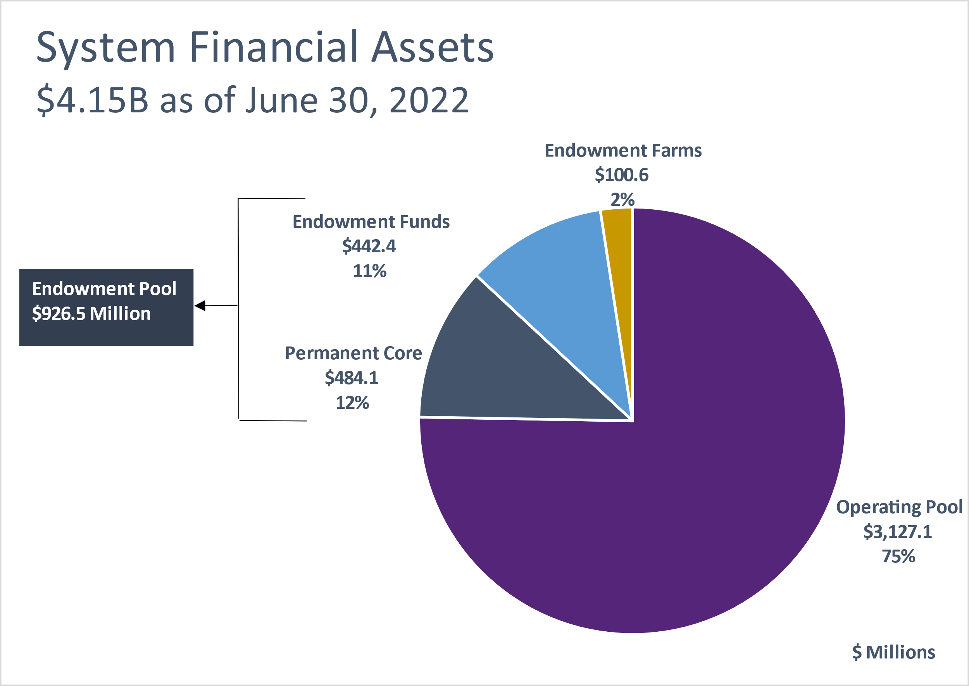
university Operating and endowment funds: June 30, 2022
The System’s financial assets were valued at $4.15 billion as of June 30, 2022.
The Operating Pool was valued at $3.13 billion (ex-Permanent Core) . The permanent core investment (gray slice) is a long-term investment of operating cash in the Endowment Pool to enhance distributions to invested units.
The combined Endowment Pool is valued at $926.5 million (gray and blue slices) and is discussed further on the following slides.

Slide 6
ENDOWMENT POOL UPDATE:
June 30, 2022

Slide 7
Market value and asset allocation: endowment pool
Over/Under Allocation to Long-Term Policy Targets

Slide 8
Total endowment pool performance (June 30, 2022)
Over the one-year period, the endowment returned -4.8%, adding 80 basis points. Real assets (+26.5%), private equity (+17.5%), and diversifying strategies (+2.4%) added to performance.
Over the ten-year period, the endowment posted a 7.8% return, supported by solid returns from private equity (+15.9%), U.S. equity (+12.0%), and real assets (+8.0%).
Endowment Pool | Quarter Ending
Market Value Change | June-2022
Beginning Market Value | $994.8 M
Net Contributions | ($4.7 M)
Gain/Loss | ($63.5 M)
Ending Market Value | $926.5 M
Note: The beginning market value + net contributions + net investment gains referenced in the table may not equal the ending market value due to rounding.

Slide 9
Asset class performance: endowment pool (June 30, 2022)
 | Current Allocation (%) | Policy Allocation (%) | Quarter ending Jun-2022 | 1 Year | 3 Years | 5 Years | 10 Years | Since Inception | Inception Date
Endowment Pool |  |  | -6.4 | -4.8 | 7.0 | 6.9 | 7.8 | 8.1 | Sep-87
Performance Benchmark |  |  | -6.2 | -5.6 | 7.6 | 7.3 | 8.2 | 8.3
GLOBAL EQUITY | 55.4 | 58.0 | -12.5 | -11.3 | 9.2 | 9.0 | 10.2 | 8.1 | Sep-87
Total U.S. Equity |  |  | -16.8 | -14.7 | 9.5 | 9.9 | 12.0 | 9.3 | Sep-87
U.S. Equity Benchmark |  |  | -16.7 | -13.9 | 9.7 | 10.5 | 12.5 | 9.6
Total Non-U.S. Equity |  |  | -14.2 | -19.9 | 1.5 | 2.5 | 5.4 | 4.9 | Sep-93
Non-U.S. Equity Benchmark |  |  | -14.3 | -19.9 | 1.6 | 2.5 | 5.0 | 5.0
Total Private Equity |  |  | 0.0 | 17.5 | 27.2 | 22.9 | 15.9 | 7.7 | Jan-04
Private Equity Benchmark |  |  | 0.0 | 8.9 | 20.8 | 18.6 | 18.1 | 13.6
GLOBAL FIXED INCOME ¹ | 19.9 | 20.0 | -4.1 | -7.7 | 0.6 | 1.8 | 2.4 | 6.3 | Sep-87
Total Public Fixed Income |  |  | -4.4 | -9.0 | -0.2 | 1.3 | 2.1 | 6.2 | Sep-87
Bloomberg U.S. Aggregate |  |  | -4.7 | -10.3 | -0.9 | 0.9 | 1.5 | 5.7
Total Private Fixed Income |  |  | 0.0 | 18.8 | 19.4 | - | - | 19.4 | Jan-18
Bloomberg U.S. Corporate HY Index |  |  | -9.8 | -12.8 | 0.2 | - | - | 1.7
REAL ASSETS ¹ | 15.7 | 14.0 | 15.0 | 26.5 | 13.7 | 10.4 | 8.0 | 11.0 | Dec-06
Total Real Estate |  |  | -5.1 | 9.5 | 8.0 | 7.3 | - | 9.7 | Aug-13
Real Estate Benchmark |  |  | 4.6 | 28.4 | 11.8 | 9.4 | - | 10.9
Total Farmland² |  |  | 49.0 | 50.6 | 21.5 | 14.4 | 7.9 | 10.9 | Dec-06
NCREIF Cornbelt Index |  |  | 26.7 | 26.7 | 12.8 | 8.5 | 6.8 | 9.9
DIVERSIFYING STRATEGIES¹ | 8.4 | 8.0 | -1.0 | 2.4 | -9.2 | -5.8 |  | -1.5 | May-13
Total Hedge Funds |  |  | -1.1 | 2.0 | -10.4 | -6.7 | - | -2.0 | May-13
Hedge Fund Index |  |  | -1.5 | -1.1 | 7.9 | 6.1 | - | 5.0
CASH | 0.6 | 0.0 | 0.0 | 0.0 | 0.5 | 0.9 | - | 0.7
¹Global Fixed Income, Real Assets and Diversifying Strategies include allocations and performance of private investments.
²Farmland directly owned by the Endowment is valued annually on June 30.

Slide 10
OPERATING POOL UPDATE:
June 30, 2022

Slide 11
Liquidity layers: Operating pool (June 30, 2022)
OPERATING POOL LIQUIDITY LAYERS
AS OF June 30, 2022
The asset allocation strategy for the Operating Pool consists of investing funds across four liquidity layers. Board- approved ranges are depicted by the bars, while the diamonds represent the actual allocation.
Funds expected to be used within one year are invested in the primary liquidity layer.
Longer-time horizon investments, including core and permanent core, are expected to provide higher rates of return and will experience some variation in market value as capital market conditions change.
The System’s permanent core operating funds are invested in the System’s Endowment Pool investment program.
Total sum of allocation may not equal 100% due to rounding.

Slide 12
TOTAL OPERATING POOL PERFORMANCE (June 30, 2022)
Over the trailing one-year period, the Operating Pool returned -1.9%, outperforming the benchmark return.
  Most managers in the Operating Pool matched or outperformed their respective benchmarks over the period.
Over the three-, five-, ten-year, and since inception periods, the Operating Pool has outperformed the benchmark.
  The majority of the Operating Pool’s managers have either met or outperformed their respective benchmarks.
Operating Pool | Quarter Ending
Market Value Change | June-2022
Beginning Market Value | $3,324.5 M
Net Contributions | ($179.3 M)
Gain/Loss | ($18.1 M)
Ending Market Value | $3,127.1 M
Note: The Total Pool’s beginning and ending market values include bank balances in which the System earns credit to offset bank fees. The beginning market value + net contributions + net investment gains referenced in the table may not equal the ending market value due to rounding.

Slide 13
APPENDIX: MARKET ENVIRONMENT

Slide 14
Market environment
2013-2022 Annual Returns of Key Indices
 |  |  |  |  |  |  |  |  |  |  |  | 5-year | 10-year
2013 | 2014 | 2015 | 2016 | 2017 | 2018 | 2019 | 2020 | 2021 | 2022 |  |  | annual | annual
Small Cap 38.8% | Global REIT 15.0% | Large Cap 1.4% | Small Cap 21.3% | Emerging Markets 37.3% | Bonds 0.0% | Large Cap 31.5% | Small Cap 20.0% | MLPs 40.2% | MLPs 10.0% |  |  | Large Cap 11.3% | Large Cap 12.9%
Large Cap 32.4% | Large Cap 13.7% | Bonds 0.5% | MLPs 18.3% | Int'l 25.0% | High Yield -2.1% | Small Cap 25.5% | Large Cap 18.4% | Large Cap 28.7% | Hedge Funds -6.7% |  |  | Small Cap 5.2% | Small Cap 9.4%
MLPs 27.6% | Bonds 6.0% | Hedge Funds -0.3% | High Yield 17.1% | Large Cap 21.8% | Hedge Funds -4.0% | Int'l 22.0% | Emerging Markets 18.3% | Global REIT 25.7% | Bonds -10.3% |  |  | Hedge Funds 3.6% | Int’l 5.4%
Int'l 22.8% | Small Cap 4.9% | Global REIT -0.8% | Large Cap 11.9% | Small Cap 14.6% | Large Cap -4.4% | Global REIT 21.9% | Hedge Funds 10.9% | Small Cap 14.8% | High Yield -14.2% |  |  | Int’l 2.2% | Global REIT 5.1%
Hedge Funds 9.0% | MLPs 4.8% | Int'l -0.8% | Emerging Markets 11.2% | Global REIT 10.4% | Global REIT -5.6% | Emerging Markets 18.4% | Int'l 7.8% | Int'l 11.3% | Emerging Markets -17.6% |  |  | Emerging Markets 2.2% | High Yield 4.5%
High Yield 7.4% | Hedge Funds 3.4% | Small Cap -4.4% | Global REIT 4.1% | Hedge Funds 7.8% | Small Cap -11.0% | High Yield 14.3% | Bonds 7.5% | Hedge Funds 6.0% | Int’l -19.6% |  |  | Global REIT 2.1% | Hedge Funds 3.7%
Global REIT 3.7% | High Yield 2.5% | High Yield -4.5% | Bonds 2.6% | High Yield 7.5% | MLPs -12.4% | Bonds 8.7% | High Yield 7.1% | High yield 5.3% | Large Cap -20.0% |  |  | High Yield 2.1% | Emerging Markets 3.1%
Bonds -2.0% | Emerging Markets -2.2% | Emerging Markets -14.9% | Int'l 1.0% | Bonds 3.5% | Int'l -13.8% | Hedge Funds 8.4% | Global REIT -9.0% | Bonds -1.5% | Global REIT -20.7% |  |  | Bonds 0.9% | Bonds 1.5%
Emerging Markets -2.6% | Int'l -4.9% | MLPs -32.6% | Hedge Funds 0.5% | MLPs -6.5% | Emerging Markets -14.6% | MLPs 6.6% | MLPs -28.7% | Emerging Markets -2.5% | Small Cap -23.4% |  |  | MLPs -0.3% | MLPs 0.7%

Slide 15
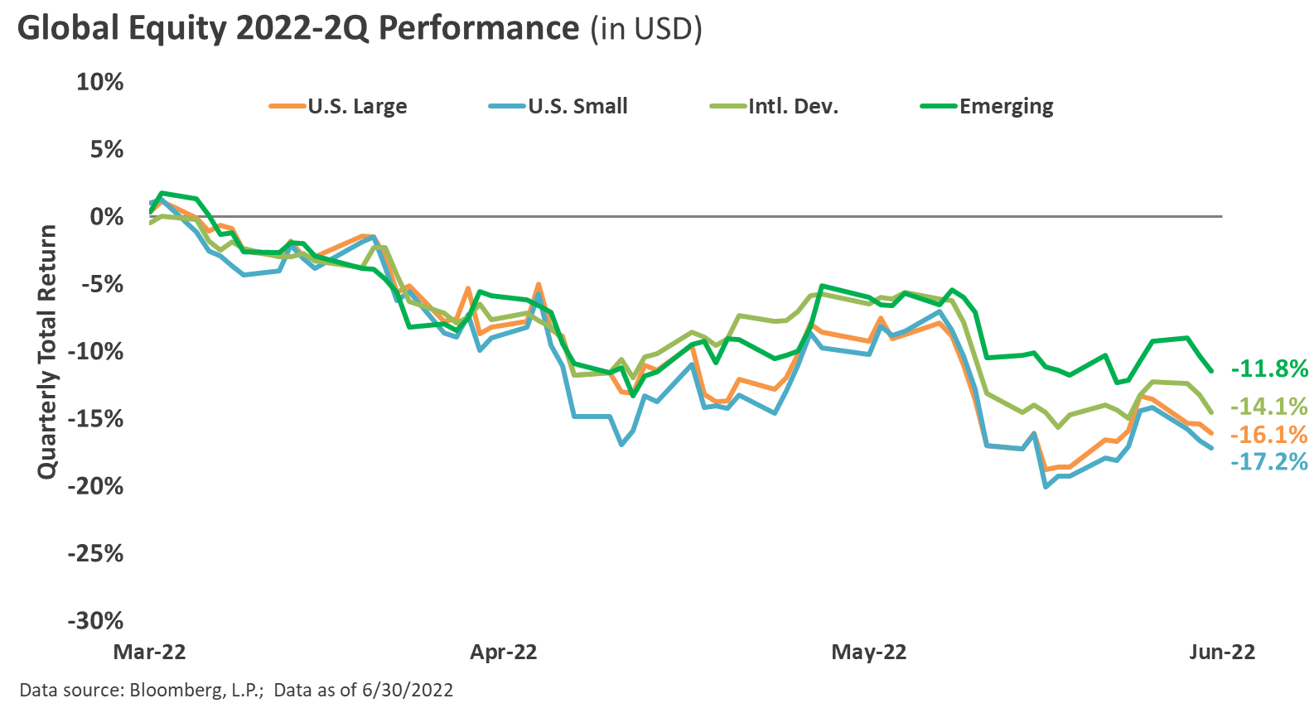
Global equity
For the second consecutive quarter, global equities faced significant performance pressure, as inflation continued to surprise to the upside, prompting the Federal Reserve to aggressively tighten policy despite growing signs of an economic slowdown.
In spite of a sharply appreciating U.S. dollar (USD) and weakening economic fundamentals across China and Europe, international equities experienced relative outperformance versus domestic.
Large cap modestly outperformed small cap, the fifth consecutive quarter of outperformance by large cap, while from a style perspective, the longer-duration growth sector continued to witness relative underperformance versus value.

Slide 16
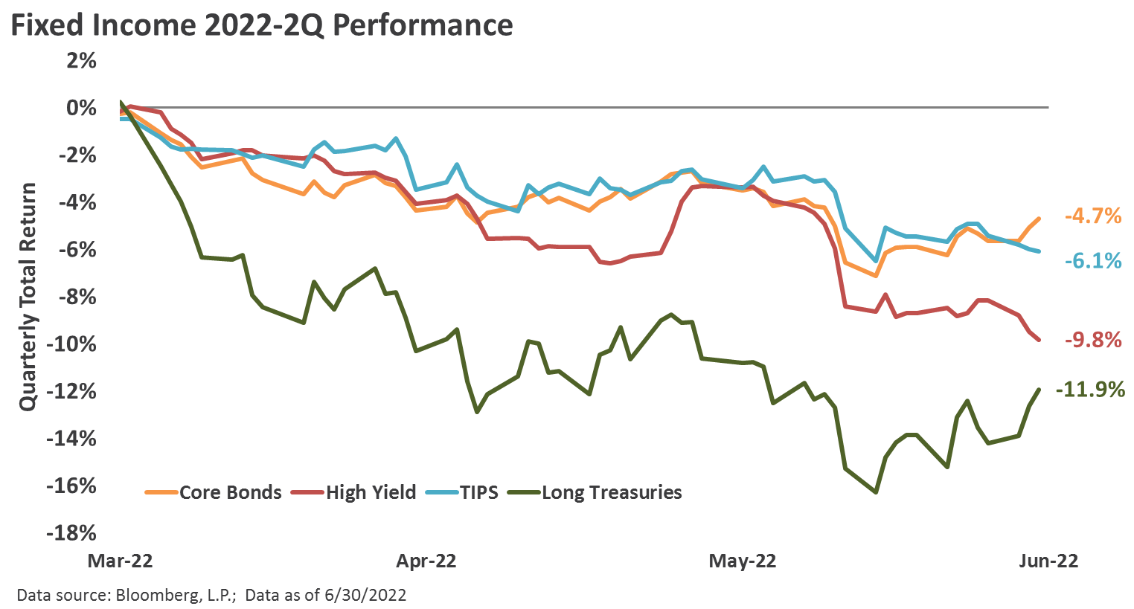
Fixed income
Similar to global equities, bond sectors posted broadly negative returns for the second consecutive quarter, as persistent inflationary pressures and aggressive monetary policy tightening by the Fed helped send interest rates higher.
Speculative grade credit risk premiums increased sharply, as the option-adjusted spread on the Bloomberg U.S. Corporate High Yield Index widened more than 200 bps on the quarter to 569 bps, a level modestly above the historical average.
The Federal Reserve hiked interest rates on two separate occasions during the quarter, including a 50 bps increase to the policy rate in May followed by a 75 basis point hike in June. Moreover, the Fed initiated the balance sheet runoff process in June, the reduction in incremental liquidity of which represents a key headwind to risky assets.

Slide 17
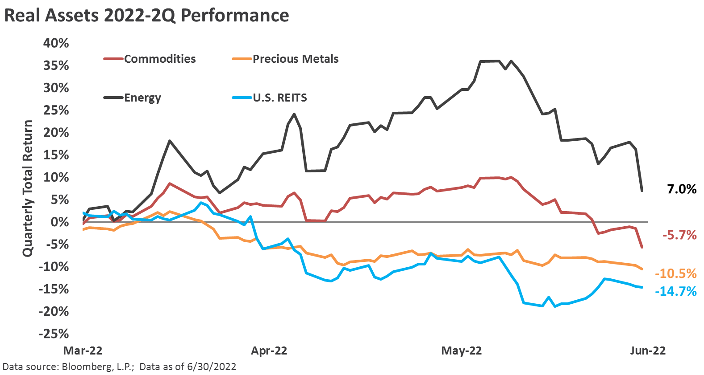
Real assets
Performance across the real assets landscape appeared disperse in the second quarter, as the real estate investment trusts (REITs) and precious metals sectors struggled throughout most of the quarter, while commodities generally exhibited strong positive momentum, but witnessed selling pressures in June amid growing economic slowdown pressures.
A further appreciation of the USD, coupled with mounting recessionary warning signs, likely served as a headwind to the real assets complex during the quarter. An ongoing global inflationary impulse, however, could result in a resumption of the strong performance across real assets that has been in place in the quarters leading up to the second quarter.

Slide 18
currencies
The USD appreciated strongly during the quarter, the trend of which has largely been in place over the trailing 1-year period, with much of the recent appreciation exhibited versus the Japanese yen and the euro, the latter of which recently approached parity versus the USD for the first time since the inception of the euro in 1999.
Emerging market currencies also came under pressure versus the USD in the second quarter, with JPMorgan’s Emerging Market Currency index declining to a fresh record low.
Many trade-weighted measures of the exchange rate value of the USD have ascended to multi-decade high levels, likely reflecting the continued bias of a reduction in U.S. monetary and fiscal accommodation and relatively easier policies abroad.

Slide 19
disclosures

Slide 20
disclosures
This presentation was prepared by Fund Evaluation Group, LLC (FEG), a federally registered investment adviser under the Investment Advisers Act of 1940, as amended, providing non-discretionary and discretionary investment advice to its clients on an individual basis. Registration as an investment adviser does not imply a certain level of skill or training. The oral and written communications of an adviser provide you with information about which you determine to hire or retain an adviser. Fund Evaluation Group, LLC, Form ADV Part 2A & 2B can be obtained by written request directed to: Fund Evaluation Group, LLC, 201 East Fifth Street, Suite 1600, Cincinnati, OH 45202 Attention: Compliance Department.
The information herein was obtained from various sources. FEG does not guarantee the accuracy or completeness of such information provided by third parties. The information in this report is given as of the date indicated and believed to be reliable. FEG assumes no obligation to update this information, or to advise on further developments relating to it.
FEG, its affiliates, directors, officers, employees, employee benefit programs and client accounts may have a long position in any securities of issuers discussed in this report.
Index performance results do not represent any managed portfolio returns. An investor cannot invest directly in a presented index, as an investment vehicle replicating an index would be required. An index does not charge management fees or brokerage expenses, and no such fees or expenses were deducted from the performance shown.
Neither the information nor any opinion expressed in this report constitutes an offer, or an invitation to make an offer, to buy or sell any securities.
Any return expectations provided are not intended as, and must not be regarded as, a representation, warranty or predication that the investment will achieve any particular rate of return over any particular time period or that investors will not incur losses.
Past performance is not indicative of future results.
This report is prepared for informational purposes only. It does not address specific investment objectives, or the financial situation and the particular needs of any person who may receive this report.

Slide 21
disclosures
Large Cap is represented by the S&P 500 Index which measures the performance of large capitalization U.S. stocks. The S&P 500 is a market-weighted index of 500 stocks that are traded on the NYSE, AMEX, and NASDAQ. www.standardandpoors.com
Mid Cap is represented by the Russell Mid Cap Index which measures performance of U.S. mid capitalization stocks. The Russell Mid Cap Index is a capitalization-weighted index of the 800 smallest companies in the Russell 1000 Index. The stocks are traded on the NYSE, AMEX, and NASDAQ. www.russell.com
Small Cap is represented by the Russell 2000 Index which measures the performance of U.S. small capitalization stocks. The Russell 2000 is a capitalization-weighted index of the 2,000 smallest stocks in the broad U.S. equity market, as defined by the Russell 3000 Index. These stocks are traded on the NYSE, AMEX, and NASDAQ. www.russell.com
International is represented by the MSCI EAFE Index which is a Morgan Stanley Capital International index that is designed to measure the performance of the developed stock markets of Europe, Australasia, and the Far East. www.mscibarra.com
Emerging Markets are represented by the MSCI Emerging Markets Index which is a Morgan Stanley Capital International index that is designed to measure the performance of emerging market stock markets. www.mscibarra.com
Hedged Equity is represented by the Hedge Fund Research, Inc. Fund Weighted Composite Index, an equal weighted index that includes over 2,000 constituent funds, both domestic and offshore with no Fund of Funds included in the index. www.hfri.com
Bonds are represented by the Barclays U.S. Aggregate Bond Index which includes U.S. government, corporate, and mortgage-backed securities with maturities up to 30 years. www.barclays.com
High Yield is represented by the Barclays U.S. Corporate High Yield Index. www.barclays.com
Global REIT is represented by the FTSE EPRA/NAREIT Developed Index which is designed to track the performance of listed real estate companies and REITS worldwide. www.ftse.com
MLPs are represented by the Alerian MLP Index. www.alerian.com
Hedge Funds are represented by the Hedge Fund Research, Inc. Fund of Funds Composite Index. www.hfri.com

