Slide 1
REMARKS TO THE
BOARD OF TRUSTEES
President Tim Killeen
September 23, 2021
Notes:
Thank you again, Chair Edwards, and good morning everyone.

Slide 2
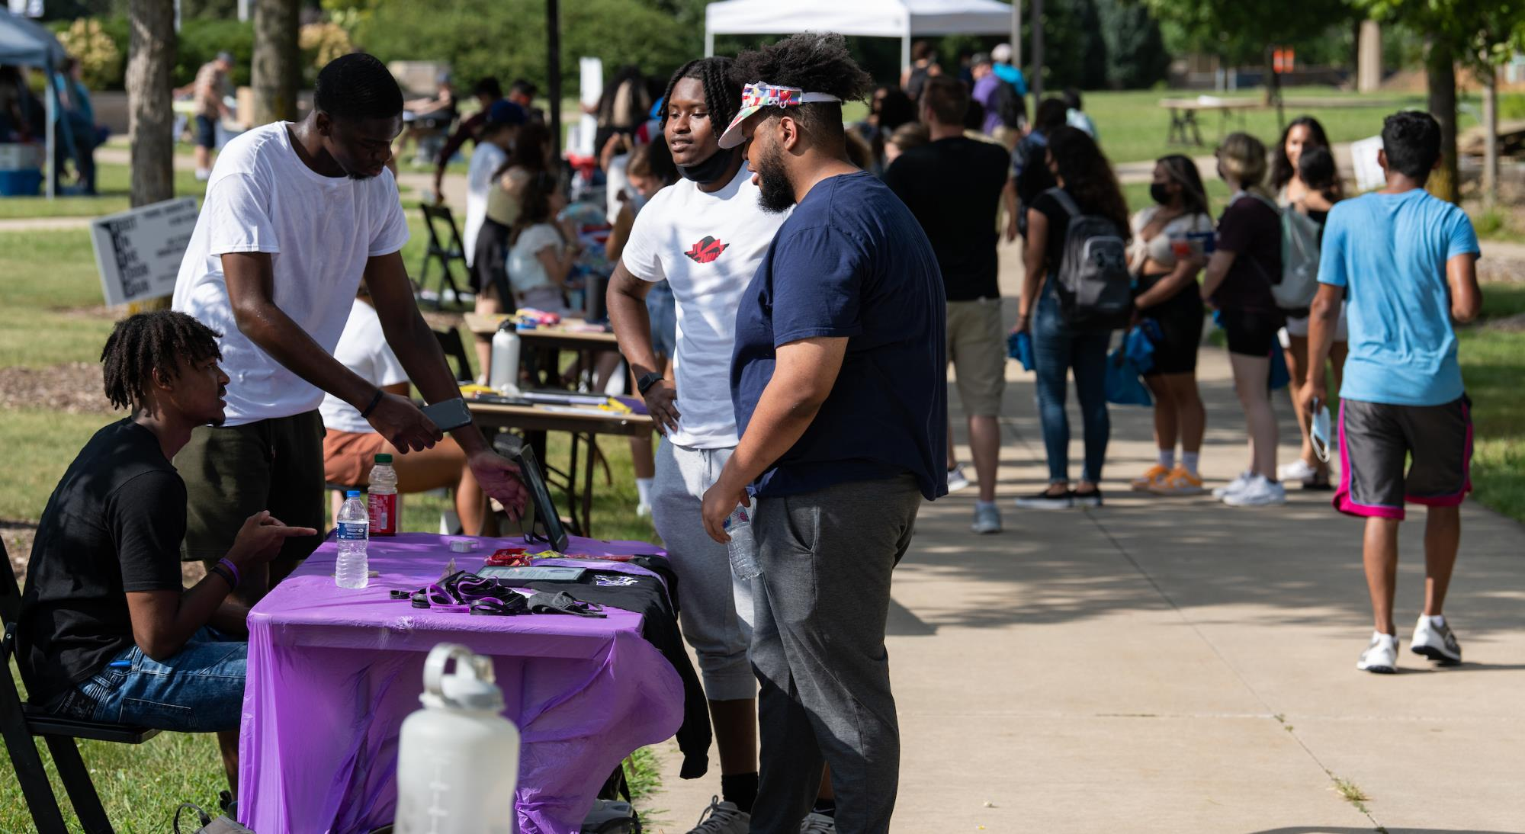
Notes:
There is always something special about the start of the fall semester, watching wide-eyed new students explore our campuses for the first time and the happy reunions of old friends catching up after a summer apart.

Slide 3
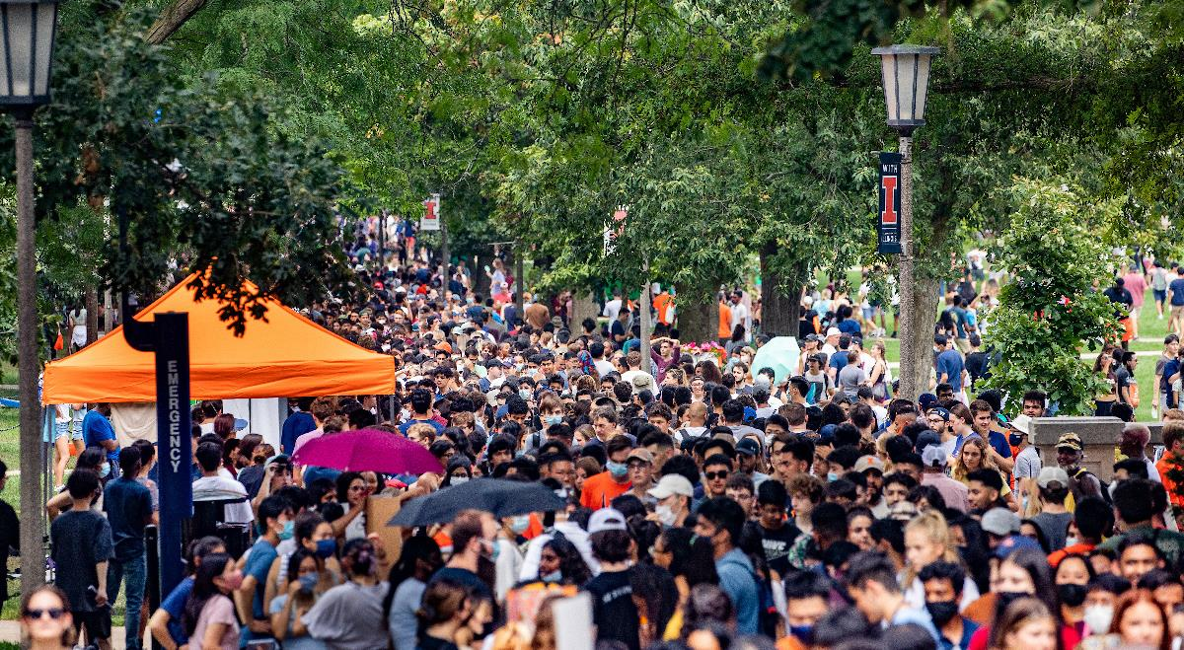
Notes:
It is an annual snapshot of the very core of what we are all about … opening doors of opportunity that transform students’ lives, one by one, and collectively feed the pipeline of world-class talent that will move our state and nation forward.

Slide 4
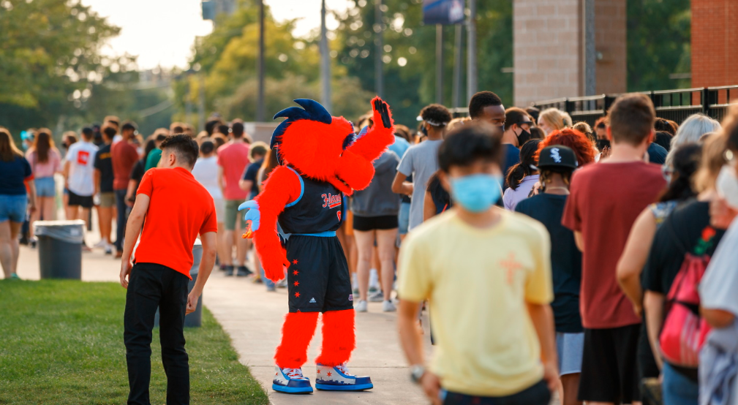
Notes:
This year, our doors again opened wider than ever before.

Slide 5
94,500
Up nearly 5%
Notes:
System-wide, enrollment grew to 94,500 students across our three universities.
It is an all-time high for the ninth straight year, increasing nearly 5 percent over the fall of 2020 despite the continued pressures of a global pandemic.

Slide 6
Enrollment
Fall 2021 | 56,299
Fall 2020 | 52,331
Change | +7.5%
Fall 2021 | 34,199
Fall 2020 | 33,518
Change | +2%
Fall 2021 | 3,944
Fall 2020 | 4,146
Change | -4.9%
Notes:
Urbana-Champaign also set a record, topping 56,000 students and welcoming its largest-ever freshman class of over 8,000.
UIC grew to a record of more than 34,000 students, fueled by an 18% increase in the number of first-year undergraduates.
UIS saw a slight decline but encouraging increases in both on-campus and international students.

Slide 7
Strategic Framework’s 5-year enrollment plan
FALL 2017
81,499
2021 GOAL 93,600
2021 ACTUAL 94,750
INCREASE 1,150
Notes:
System-wide enrollment also topped an ambitious five-year goal that the Board of Trustees set in 2017 as part of our Strategic Framework.
The high-aspiration target sought a nearly 15 percent increase from the 81,500 students enrolled that fall, seeking to add about 12,000 more and reach 93,600 students by our current fall semester.
Actual enrollment grew 16 percent, giving more than eleven-hundred additional students the life-changing opportunities that a U of I education provides.
The 13,000 students we have added over the last five years is like creating another state university the size of SIU-Carbondale, and equals the population of Illinois cities like Crestwood, Kewanee, Centralia and Effingham.
Our continued growth has been a true team effort … a credit to the hard work of our admissions staff, to the faculty and staff who drive our academic excellence, to the dedication of our university and system leadership, and to our commitment to student affordability and success, including an in-state tuition freeze in six of the last seven years.
My thanks to all of them, and to the board for always challenging us to do more and supporting us along the way.

Slide 8
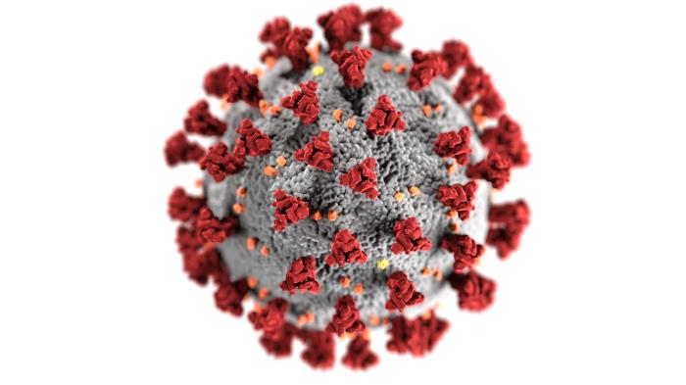
Notes:
Our record crop of students across the system returned to a more traditional campus experience this fall, with most classes in-person again after a year of largely hybrid learning due to COVID.
And just like last year, when we led the way thanks to our groundbreaking SHIELD testing protocol, no campuses in the nation are safer than ours.

Slide 9
Vaccination rates
91%
81%
95%
92%
94%
92%
Students
Faculty/Staff
Students
Students
Faculty/Staff
Faculty/Staff
Notes:
Students, faculty and staff have responded overwhelmingly to vaccination requirements that were put in place for the safety of our universities and the communities they call home.
Rates for students and employees who are fully vaccinated are far, far above national and state rates of just above 50%.
In fact, on every campus, our fully vaccinated rates for students and employees top the U.S. and Illinois rates for people who have received even one dose.
As of last Sunday, 91% of students and 81% of faculty and staff were fully vaccinated in Urbana-Champaign.
At UIC, rates were 95% for students and 92% for faculty and staff.
At UIS, rates were 94% for students and 92% for faculty and staff.
I am so proud of all of them for their commitment to safety, to each other and to moving us beyond this global crisis that has gripped our lives for so long.

Slide 10
POSITIVITY RATES
0.18%
0.53%
0.09%
4.4%
Notes:
Coupled with testing for those with exemptions from vaccinations as well requirements such as indoor masking requirements, positivity rates at our universities are well below the state’s 7-day rolling average, which stood at 4.4% as of last Sunday.
Our 7-day averages are about half of 1 percent or less at each of our universities … 0.18% at UIUC, 0.53% at UIC and 0.09% at UIS.
Across the system, we have seen just one blip … a brief surge of new cases during the first week of classes in Urbana, cases that surprisingly were mostly among the fully vaccinated.
Even that surge pushed positivity rates to around 2 percent for only a day and 7-day averages remained under 1 percent, as they have since early September of 2020.
Still, the virus and its variants have taught us to expect the unexpected.
So we will stay on our toes, prepared to tweak or even overhaul our operations as needed to ensure the safety of our students and employees.

Slide 11
Notes:
The SHIELD testing protocol that has been a cornerstone of our safety over the last 19 months continues to expand around the world, thanks to the work of our SHIELD Illinois and Shield T3 teams.

Slide 12
SOME KEY STATS
Nearly 450 K-12 schools districts in Illinois with over 1,800 schools
More than 75 universities and community colleges
The city of Chicago
The Illinois General Assembly
ADM, Rivian and other employers
Community based sites covering 70% of the state’s population
Cities and towns across the country and around the world
Notes:
Nearly 450 K-12 school districts in Illinois have signed up to use the saliva-based tests for the 2021-22 academic year, making tests available in more than 1,800 school buildings with over 950,000 students and 130,000 employees through funding provided by the state.
Others in Illinois using the tests include more than 75 universities and community colleges; the city of Chicago; the General Assembly; ADM, Rivian and other employers; and community-based sites covering 70% of the state’s population, with more on the way.
Our tests are also serving people across the country … from Maryland to California … and in nations such as New Zealand and the Philippines.
The homegrown innovation is a source of pride not just for us but for every citizen of Illinois … a reflection of the power of their flagship university system and its commitment to their future.

Slide 13
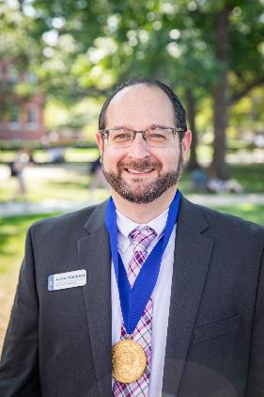
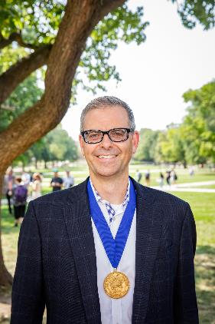
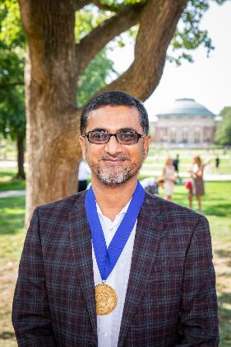
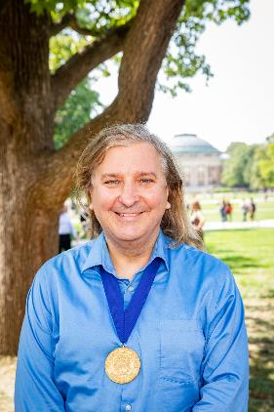
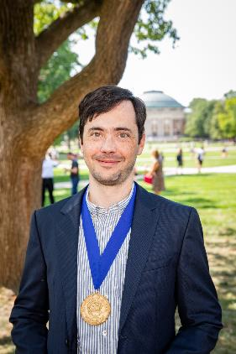
Medallion ceremony
Notes:
Last month, I had the honor of presenting Presidential Medallions to 30 key leaders in the U of I System’s extraordinary response to the COVID-19 pandemic.

Slide 14
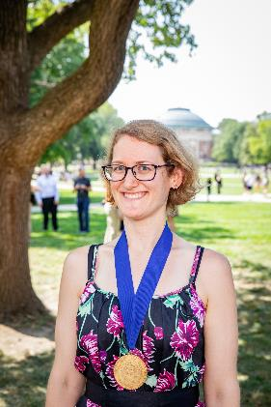
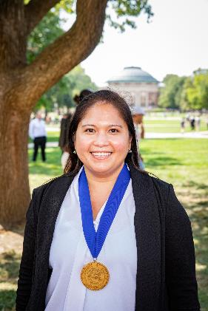
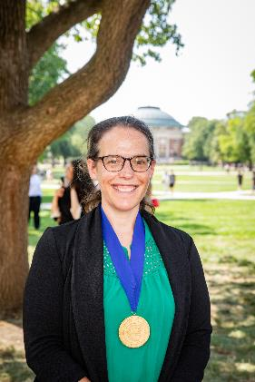
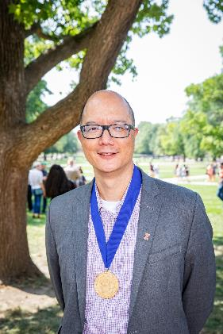
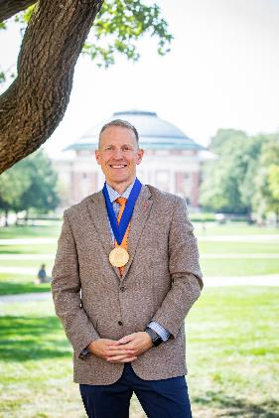
Medallion ceremony
Notes:
These remarkable colleagues led the development of UIUC’s breakthrough SHIELD test-and-trace system and the organizations created to share it around the world.

Slide 15
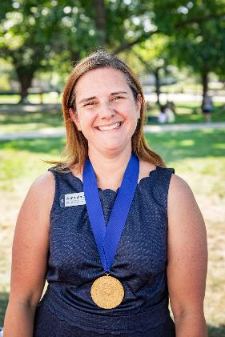
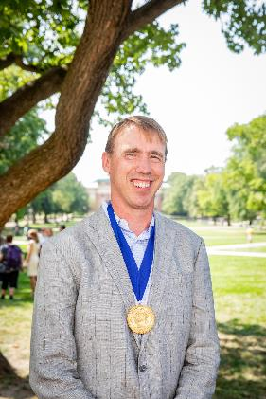
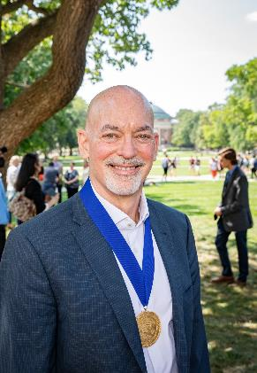
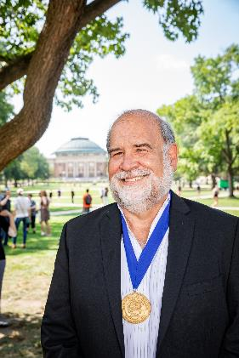
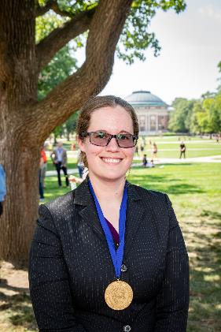
Medallion ceremony
Notes:
Others were behind UIC’s clinical trials for vaccines and treatments, including the Moderna and Johnson & Johnson vaccines, as well as mass-vaccination efforts at UIC that have gotten shots into tens of thousands of arms.

Slide 16
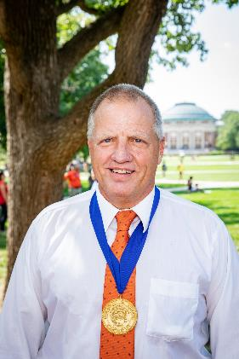
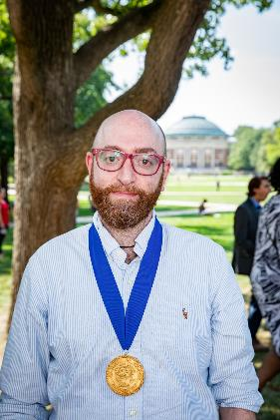
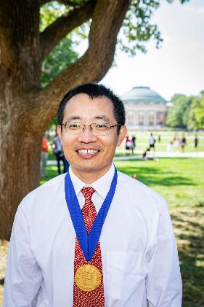
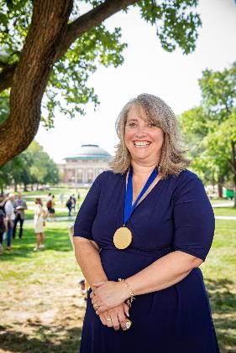
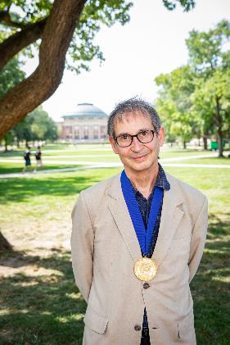
Medallion ceremony
Notes:
The medallions are the highest honor my office can bestow and recognize individuals who bring distinction to the U of I System; enhancing and accelerating its ability to deliver on its life-changing missions.

Slide 17
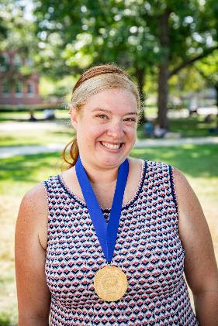
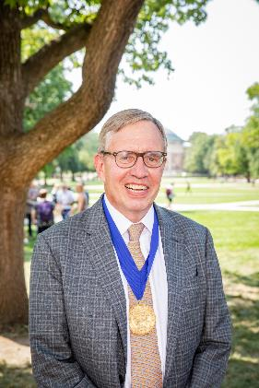
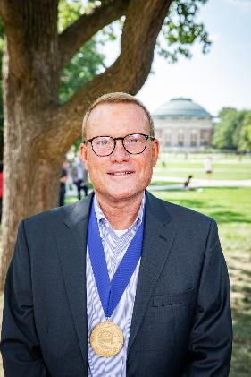
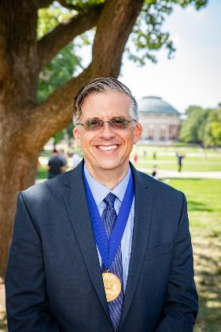
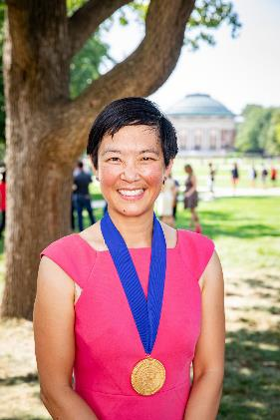
Medallion ceremony
Notes:
They are the first I have awarded in my more than six years as president, and this marked just the 18th time the awards have been presented since the program was created nearly 40 years ago.

Slide 18
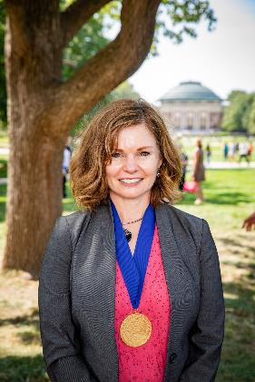
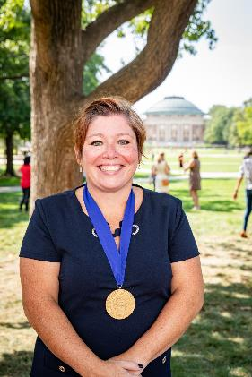
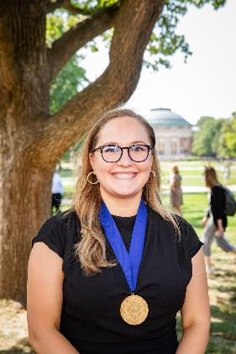
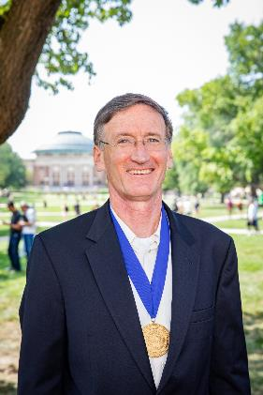
Medallion ceremony
Notes:
I hope all of you are as proud of these incredible colleagues as I am.
Their work, supported by hundreds and hundreds of dedicated faculty and staff across the system, has been literally lifesaving, and has demonstrated in real time what the U of I System means to the people of Illinois and beyond.

Slide 19
THANK YOU
Notes:
My thanks again to all of them and to the board for its encouragement, its guidance and its service to our three remarkable universities.

